Slide 1
Introduction to NCI’s VDI
2019 AMOS Darwin
Jingbo Wang & Kate Snow

Slide 2
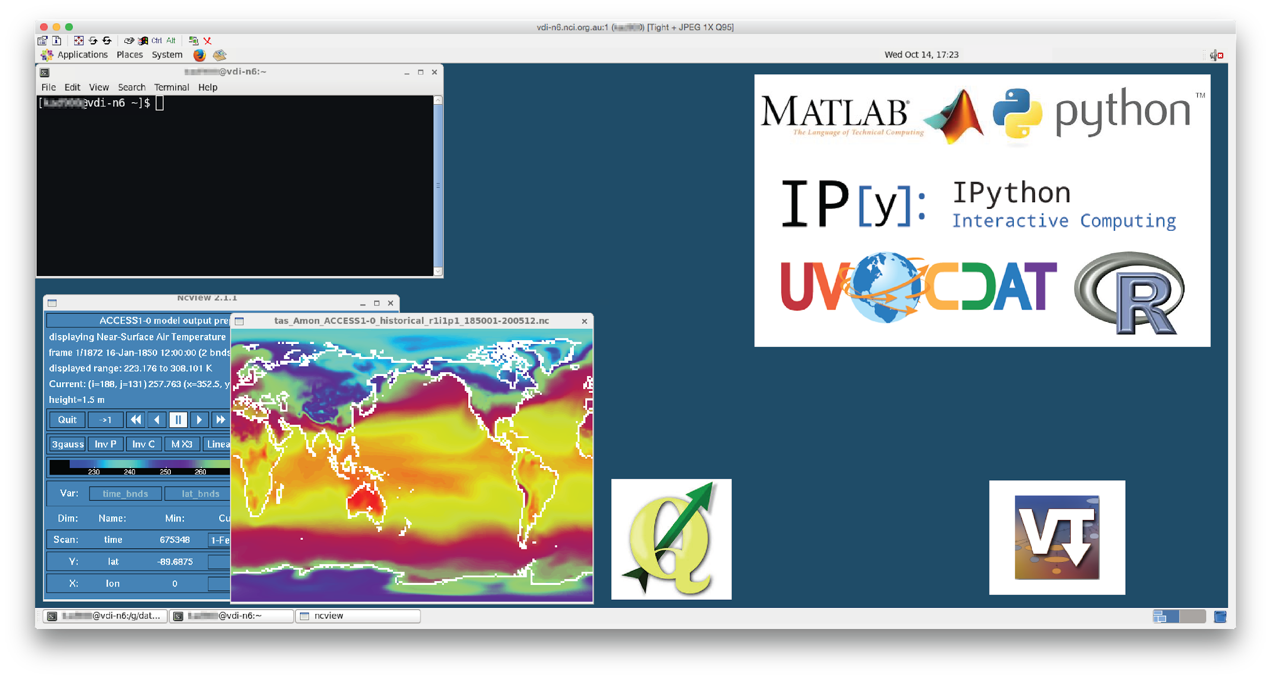

What is a virtual laboratory?
A Virtual Laboratory is an interactive environment for creating and conducting simulated experiments via a computer interface.
It provides a range of domain-specific digitally enabled data, programs and tools.
NCI's VDI/VL team provides access to Virtual Desktop Infrastructure on NCI internal resources (separate to NeCTAR cloud resources).

Slide 3
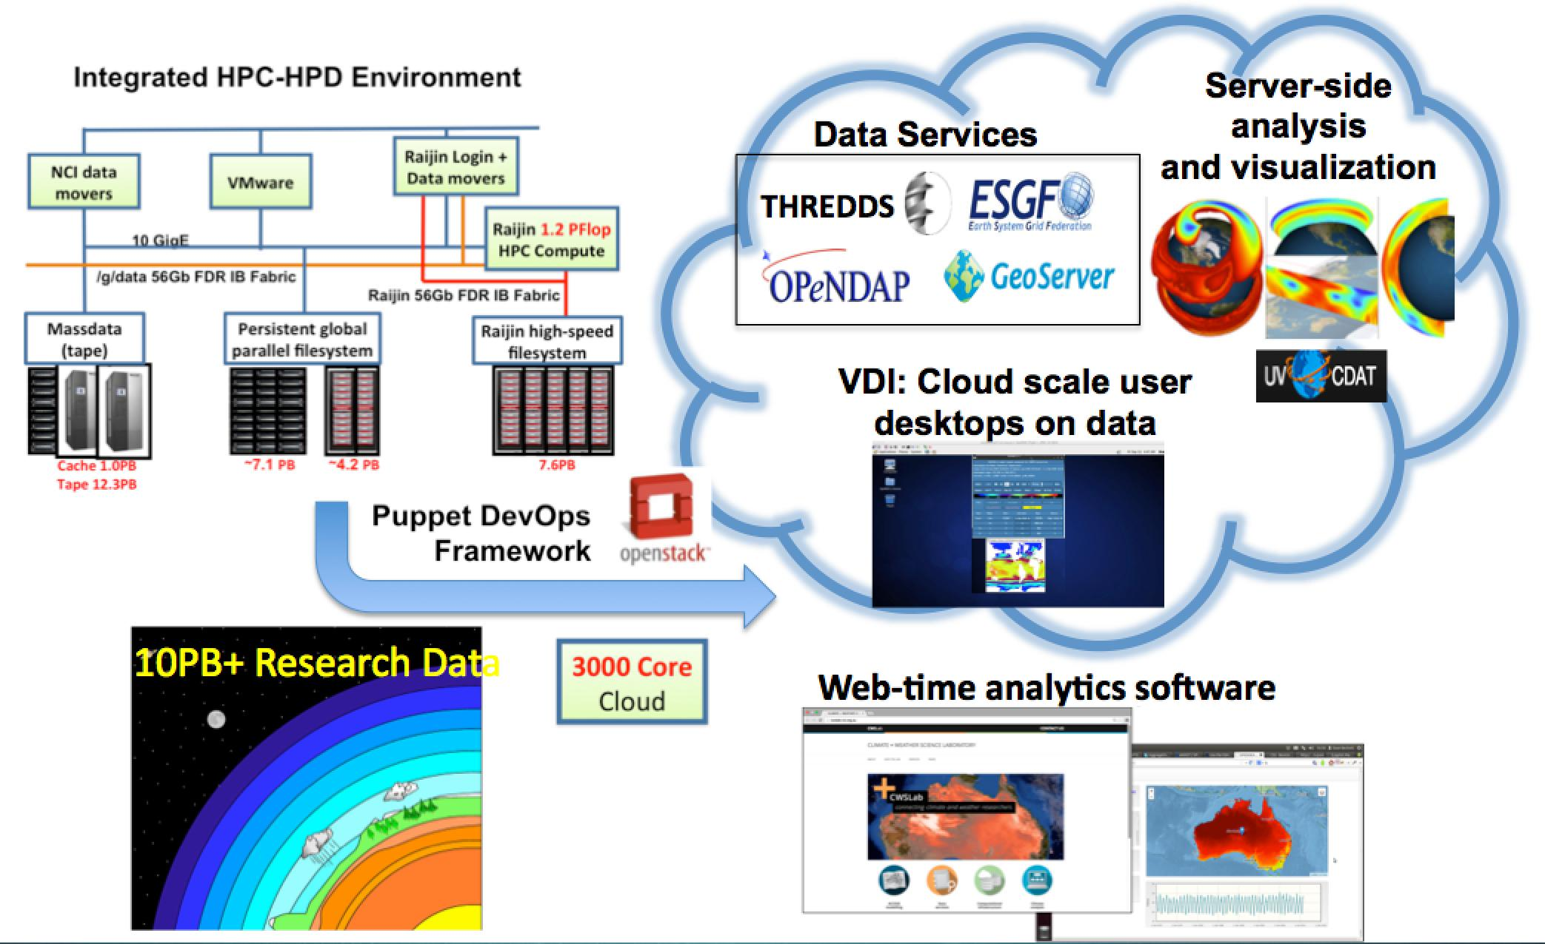
How VDI fits within NCI

Slide 4
Virtual Desktop Infrastructure (VDI)
The VDI http://nci.org.au/systems-services/national-facility/vdi/* provides:
Access to our software library including:
Climate, weather, geospatial analysis tools and libraries
Research, analysis and visualisation tools
Workflow tools that enable traceability and reproducibility
Standard compilers and libraries
Integration with NCI’s HPC infrastructure, allowing
Direct access to our data collections as well as global filesystems for NCI project data directories
Fast and reliable access to our data services using internal network
Consistent with the raijin set-up, but more interactive tools
Can allow job submission to raijin
The VDI is also a useful platform for sharing code and using ipython notebooks
* The link above might not be available anymore when new NCI website is launched in the next month or so.

Slide 5
VDI specs
Current NCI VDI pool resources:
Limited availability
When the number of desktop nodes in the pool (currently 28) are exhausted then resources are shared between users by allocating more than one user per desktop node. Please be considerate of your fellow users. Check who and top.
Maximum session times apply to allow VMs to return to the pool in a timely manner, please completely log out whenever not in ongoing use.
Pool | Configuration
NCI Virtual Desktop | 8 vCPUs, 32GB RAM, 140GB “/local” Looks like (and is) a normal Linux UI – CentOS 6. Max session lifetime: 7 days Inactive session time limit: 24 hours

Slide 6
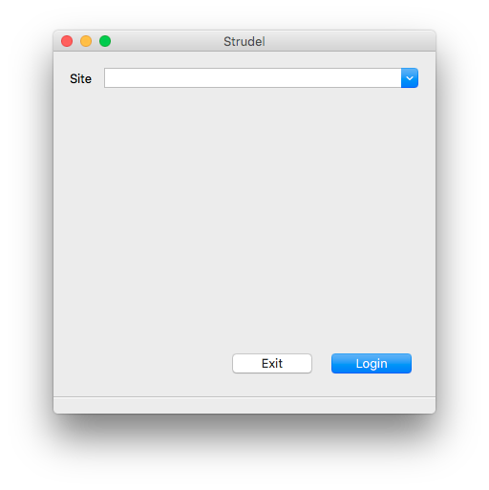
Getting started
Launch Strudel from your computer
On the first login, you might see a window similar to this one where there are no available sites listed yet.

Slide 7
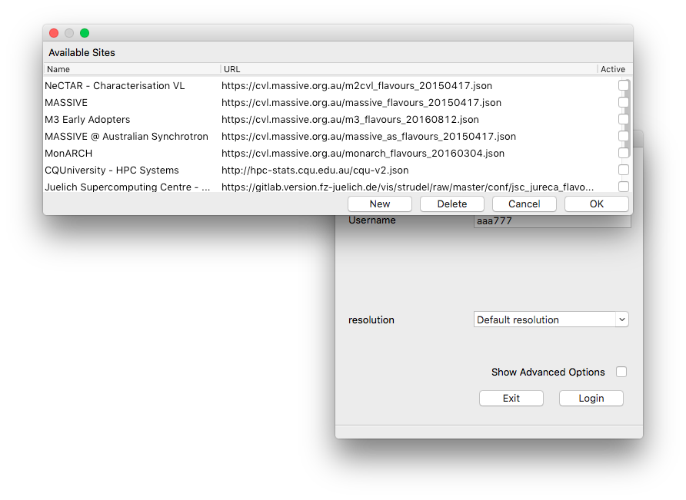
Getting started
To add NCI’s VDI to the Site list (only need to do this once on the initial login):
Navigate to the File menu and select Manage sites
Select New to add a new site to the list

Slide 8
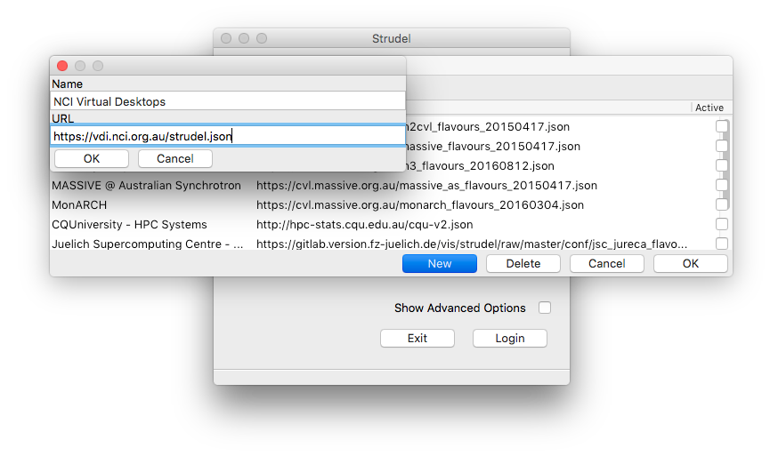
Getting started
To add NCI’s VDI to the Site list (only need to do this once on the initial login):
Navigate to the File menu and select Manage sites
Select New to add a new site to the list
Next, enter the following details:
Name: NCI Virtual Desktops
URL: https://vdi.nci.org.au/strudel.json
Select OK

Slide 9
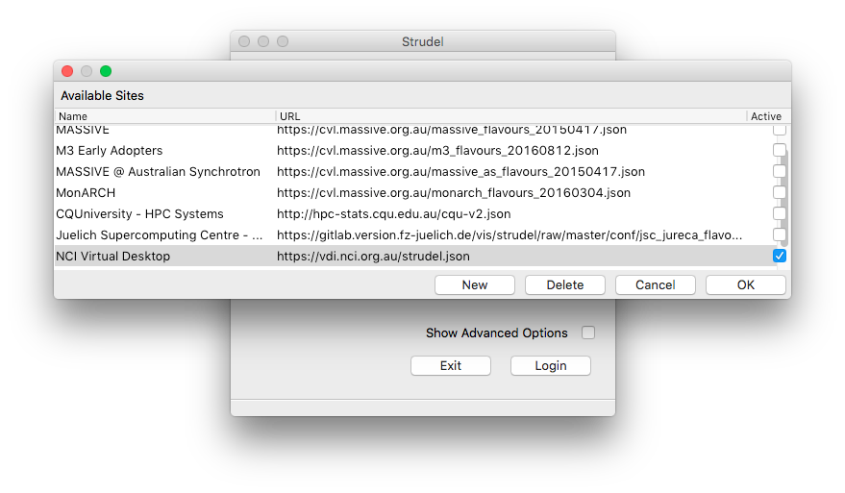
Getting started
To add NCI’s VDI to the Site list (only need to do this once on the initial login):
Navigate to the File menu and select Manage sites
Select New to add a new site to the list
Next, enter the following details:
Name: NCI Virtual Desktops
URL: https://vdi.nci.org.au/strudel.json
Select OK
Mark the box next to our new site
Select OK

Slide 10
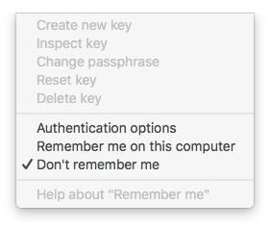
Getting started
When first logging on:
First, navigate to the Identity menu
Here we have a few authentication options
If you select Remember me... you will be asked to set up a pass phrase. Make sure this is not the same as your NCI password.
But today, we will select the Don’t remember me option.

Slide 11
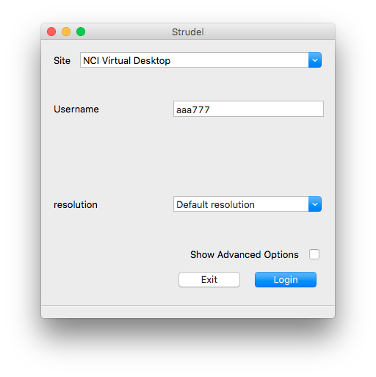
Getting started
Next:
Enter your Username and NCI password
Select Login

Slide 12
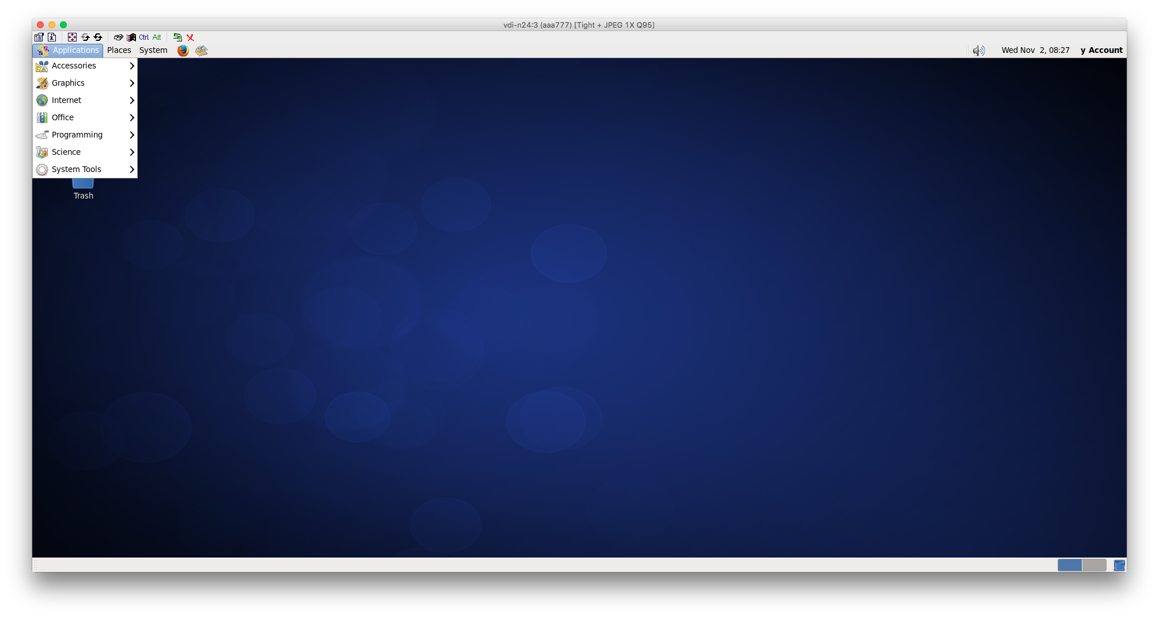
Getting started
Inspect the software available via the menus
Navigate into the menus to inspect software available via the graphical interface.

Slide 13
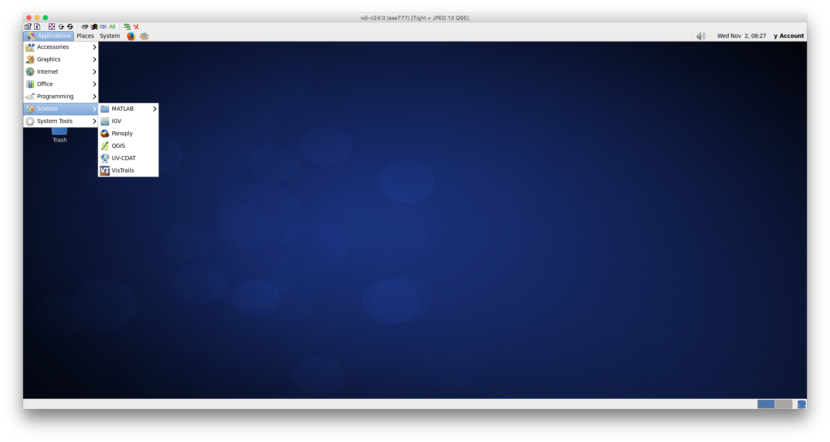
Getting started
A variety of popular science based applications are available from this menu.
Note: Matlab is proprietary software and requires licence setup to use.
Not all tools will be found from this application menu. We’ll discuss in a moment how to access the full range.

Slide 14
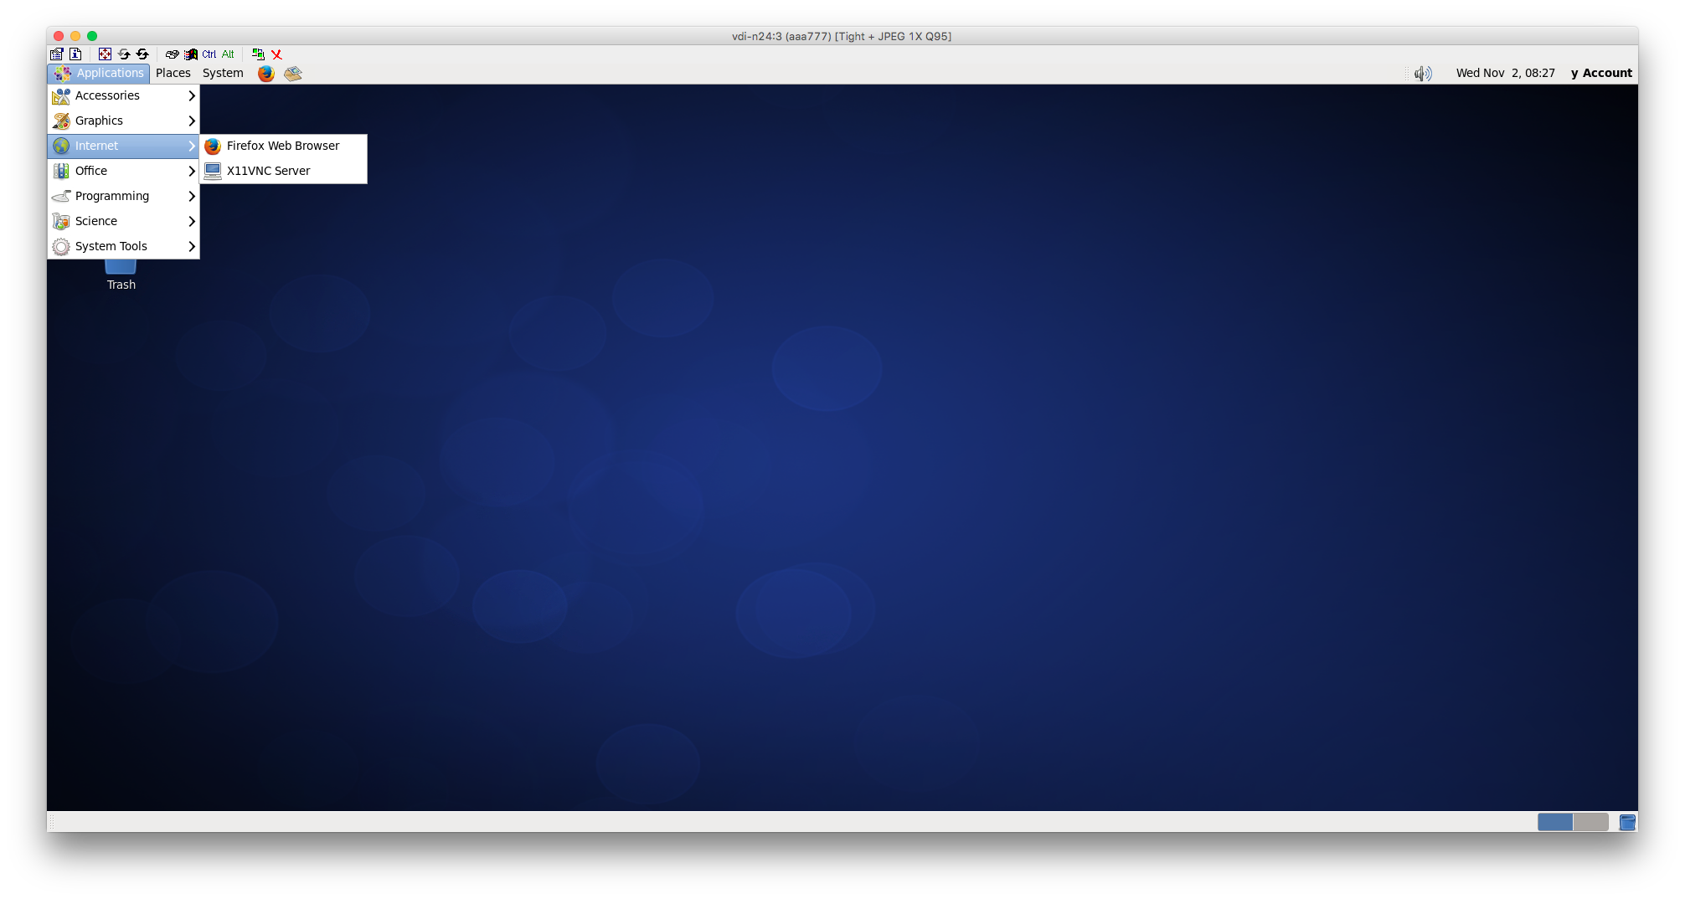
Getting started
Firefox is available for web browsing.

Slide 15
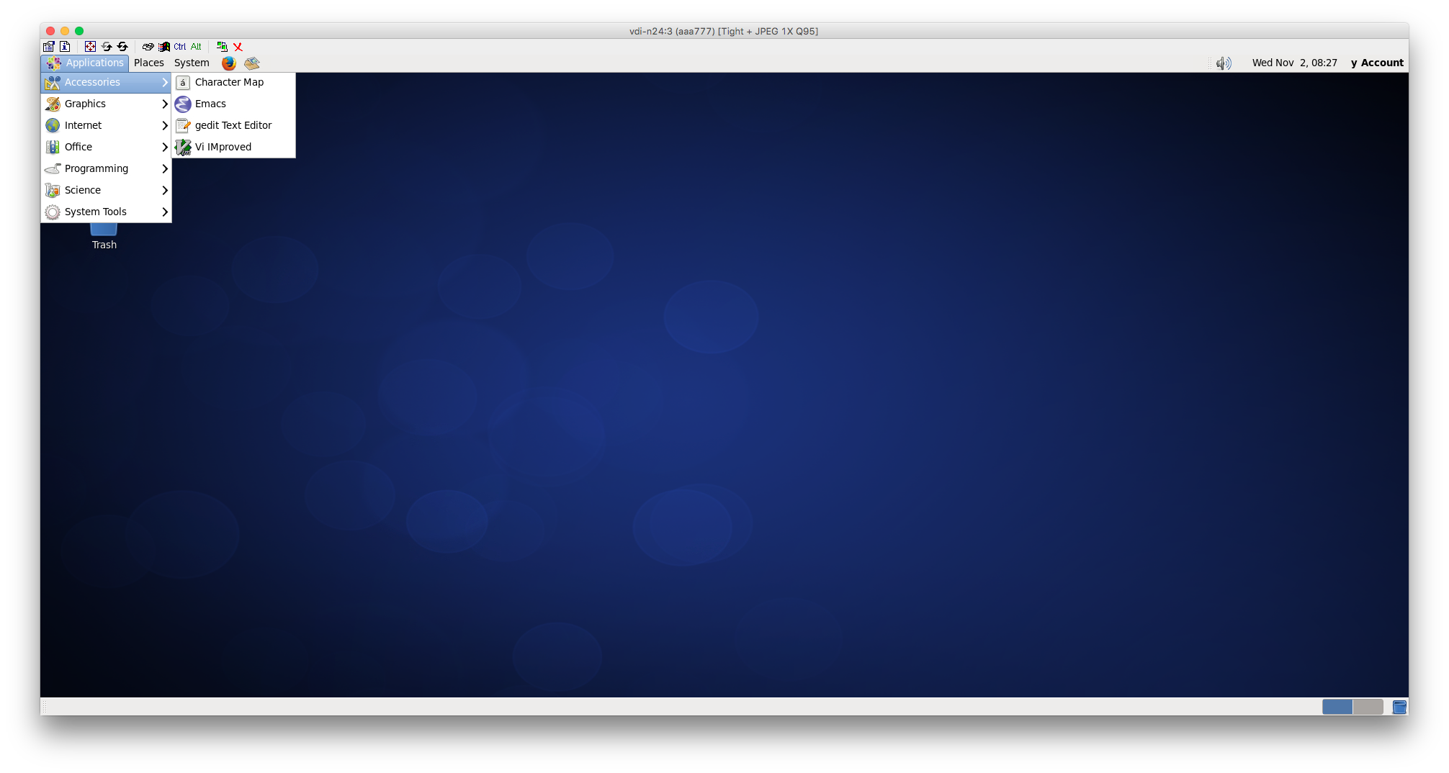
Getting started
Under accessories is where you might go to use some of the text editing tools like Emacs, gedit, and Vi if you prefer to use them via GUI than command line.

Slide 16
Logging out and disconnecting
Disconnecting
If you just want to disconnect from the virtual desktop and leave it running so that you can return to it a short time later, then simply close the VNC window.
If you temporarily lose connectivity to the desktop (eg. network dropout) then the effect is the same.
When you connect to the same desktop pool again, Strudel will prompt you to either reconnect to the existing desktop or start a new one. If you choose the later, then your existing desktop session will be terminated first.
Warning: Avoid leaving work unsaved when you disconnect from the desktop. Your desktop session will be terminated if it is left disconnected for too long, or for other reasons such as system maintenance.

Slide 17
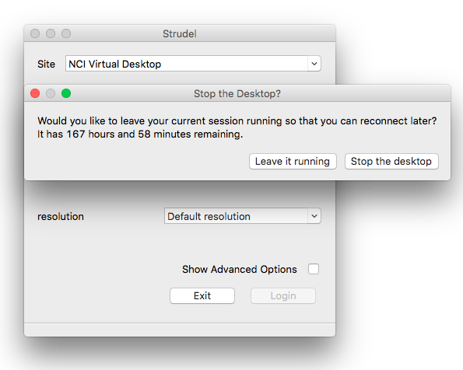
Logging out and disconnecting
Logging Out
When you have finished with your virtual desktop and wish to logout:
Click on your name in the top right hand corner of the desktop and choose “Quit” from the menu. Alternatively, you can choose “Log Out” from the “System” menu.
In either case, this will terminate all applications and end the desktop session.
You will also be asked if you would like to Leave it running or Stop the desktop
Tip: Be sure to move any important files to an appropriate location under /g/data or your home directory before ending the session.

Slide 18
VDI access
The VDI makes it easier for new scientists to get started at NCI, and to collaborate with others.
For additional information about:
Software installation and configuration
Virtual Machine specs
Quotas and session time limits
Other important information
Please see the VDI User Guide at vdi.nci.org.au/help.

Slide 19
Getting access to the VDI
Please note:
Projects do not have VDI access by default.
Please contact help@nci.org.au to request your project be granted access (must be a compute, not data, project).

Slide 20
Recap: filesystems on raijin
Filesystem | Purpose | Quota | Backup | Availability | Time limit
/home | Irreproducible data eg. source code | 2GB (user) | Yes | local | None
/short | Input/output production data files | 72GB (proj) | No | local | finite TBD
/g/data | Processing and storage of large data and collections which need fast access for publishing, e.g. RDSI. Considered a long-term storage space for frequently accessed data | project dependent | No | global | Duration of project
$PBS_JOBFS | IO intensive data in batch jobs |  | No | local to node | Duration of job
MDSS | Archiving | project dependent | 2 copies 2 locations | External - use mdss commands | None

Slide 21
Filesystems on the VDI
Unless specifically noted in the table below, files stored on the virtual desktop node are not backed up. You should treat any local storage locations as temporary for the duration of the desktop session only.
Location | Notes
/home | User home directories. Mounted across all desktop nodes. Backed up to an archival system. Disk usage quotas apply. Good place for source code. Don’t use this location for high I/O workloads as performance will be poor and will impact on all other users. The following folders in the “Places” desktop menu are included: Home Folder Desktop Documents Music Pictures Videos Downloads Note that “/home” on “raijin” is completely separate and cannot be accessed from the desktops.

Slide 22
Filesystems on the VDI
Location | Notes
/g/data /g/data1 /g/data2 /g/data3 | The global Lustre filesystem which is also available on “raijin”. Only a subset of volumes are accessible so please ask if you would like your project area to be made available. Primarily intended for persistent data outputs and shared software installations. More information can be found here: http://nci.org.au/services-support/getting-help/gdata-faqs/.
/local | Fast storage on the local node primarily intended for intermediate working files. Neither persistent nor backed up. Each user’s temporary directory (“$TMPDIR”) is set to this location. Does not involve any network traffic and is backed by an SSD on the node. Please take care not to fill up this volume as it will impact other users on the same node; currently we aren’t applying quotas but may do so in future.

Slide 23
Filesystems on the VDI
Location | Notes
/short | Note that “/short” on “raijin” is completely separate to the VDI and cannot be accessed from the desktops. We recommend using either “/g/data” or “/local” (whichever is appropriate) instead of this area as it’s currently under consideration to be removed. No new project allocations are being made here. If you have a specific need for this storage please contact us to discuss your requirements. Not backed up and not guaranteed to be persistent. Unlike “/local”, this area is shared amongst all desktop nodes so you can exchange temporary working data with other colleagues if needed. However, each project area is limited to 100GB and files will be purged automatically after 30 days. Don’t use this location for high demand I/O workloads as performance will be poor and will impact on all other users. For better performance you should use “/local” instead.

Slide 24
Transferring files to the VDI
You can access files between raijin and the virtual desktop through the /g/data shared filesystem and transfer files from other raijin filesystems e.g. unix command cp.
You can transfer files between the virtual desktop and your local machine using the following tools:
rsync
scp
Any client that supports SFTP; eg. Cyberduck or FileZilla
The name of the desktop node to connect to is usually displayed in the VNC window title bar. You can also run the following command in a terminal window on the desktop:
$ hostname
You need to append “.nci.org.au” to the node name; eg. “vdi-n1.nci.org.au”.

Slide 25
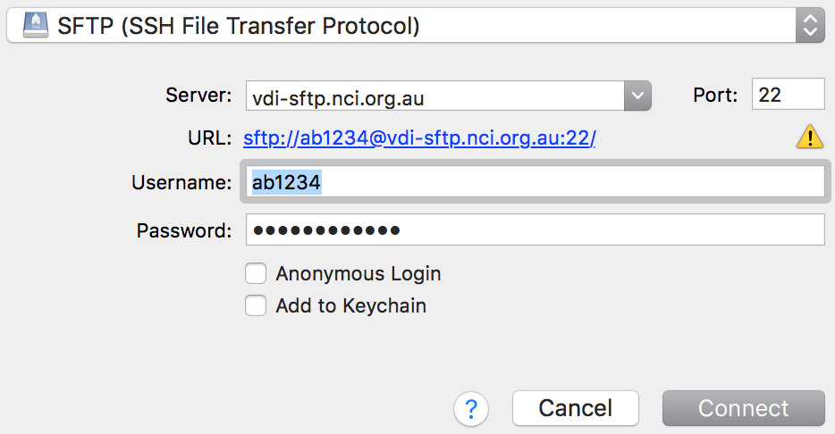
SFTP transfer node
On VDI only hard disk quota limits are used and therefore there is no grace period.
Attempts to create new files or write additional data to existing files will fail with an error if you exceed your quota.

Slide 26
SFTP transfer node
Tip:​ If your desktop session ends while you have very little or no quota left, when you try to start a new desktop session it will fail with the following error:
Unable to create job script file.
[Errno 122] Disk quota exceeded
When this occurs, you can use the SFTP transfer node to reduce your quota usage by removing some files. Note that files in the desktop “Trash” folder will consume quota until the folder is emptied by right clicking the icon and choosing “Empty Trash”. When using the SFTP transfer node, the folder path is “.local/share/Trash” in your home directory (you may need to configure your SFTP client to show hidden files).

Slide 27
Remember VDI Filesystem Caveats
/home is not the same
/home on Raijin is different to /home on the VDI. Within the VDI, /home is shared, so you can log out of a node and into another and your data/code will still be there. However, the content of your Raijin /home will not be visible from the cloud and must be copied across as needed.
The same goes for /local and other temporary space…
Remember /home and /g/data are the only persistent spaces on the VDI, everything else is wiped on logout
Strict quotas apply to /home. Do not ignore any quota warnings which appear when you connect to a desktop session, and monitor your usage with the quota command. Take action immediately – after the grace period expires you will be unable to start a new session.

Slide 28
Modules
We have seen what tools and packages are available through the menus
But there are also numerous other software packages available under Modules
Note:
If you are familiar with our raijin supercomputer, modules are viewed and loaded on the VDI in the same manner.

Slide 29
Environment modules
Modules provide a great way to easily customize your shell environment for different software packages. The module command syntax is the same no matter which command shell you are using. Various modules are loaded into your environment at login to provide a workable environment.
module list # To see the modules loaded
module avail # To see the list of software for which environments have been set up via modules
module show <name> # To see the list of commands that are carried out in the module
module load # To load the environment settings required by a software package
module unload # To remove extras added to the environment for a previously loaded software package. This is extremely useful in situations where different package settings clash.
module purge # To unload all loaded modules
module use # To use a custom module file not provided by NCI but maintained by the community

Slide 30
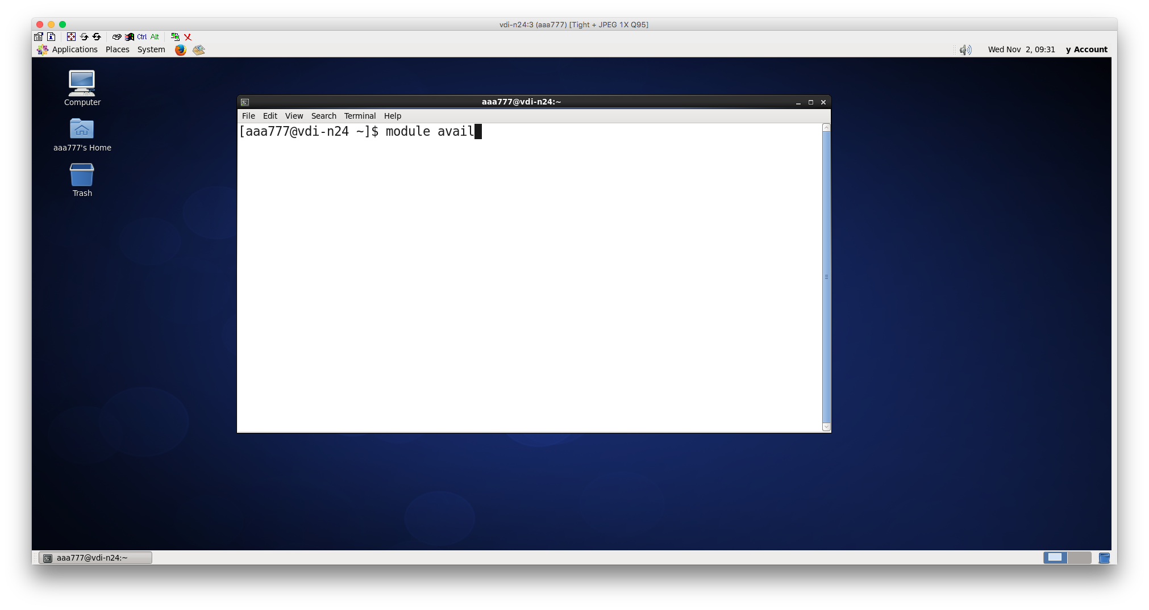
Exercise: Inspecting modules
Inspecting modules
Launch a Terminal window
Applications -> System Tools -> Terminal
Type the following:
module avail

Slide 31
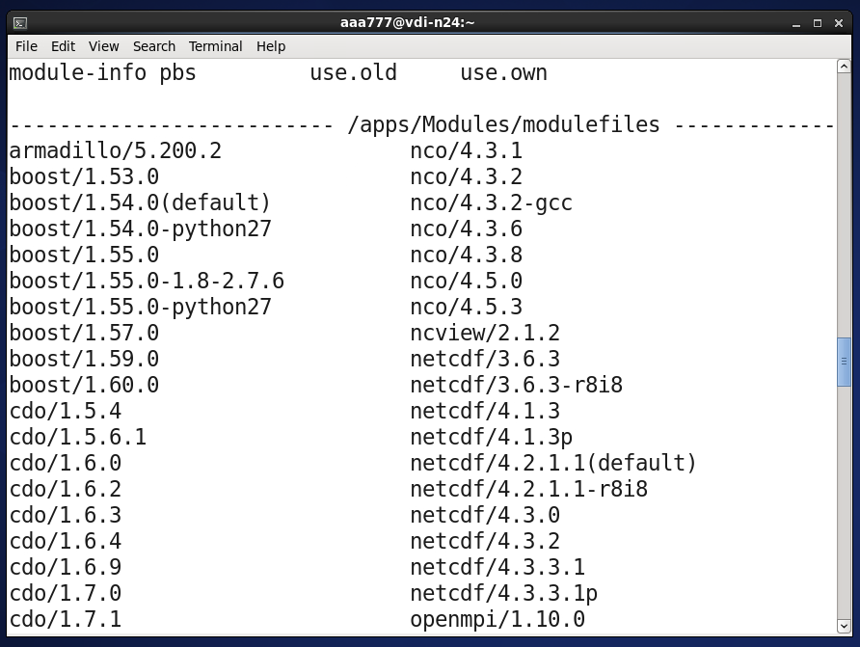
Exercise: Inspecting modules
Inspecting modules
Note these are grouped by category:
Some are only available on the VDI:
/apps/Modules/cloud/all
Others like the
/apps/Modules/modulefiles
are the same modules used on Raijin

Slide 32
Exercise: Loading modules
Now let’s practice loading and unloading modules:
This is something you will be doing quite often ... let’s do a little practicing.
Launch a new Terminal window again
Let’s look at the available modules once more:
module avail
Now let’s look at available modules that begin with “python”:
module avail python

Slide 33
Exercise: Loading modules
Loading a (python3) module:
To load a module, we use the module load command following by the module name:
module load python
Note: This will load the default python module, for specific versions the full module name must be used. E.g.,
module load python/3.5.2
To unload the module, we use the module unload command again followed by the module:
module unload python/3.5.2

Slide 34
Exercise: Loading modules
Unloading all modules:
To quickly unload all modules, the module purge can be very helpful:
module purge
However, it is only necessary when it is a really mess. It might remove the ‘pbs’ module which is what allows HPC jobs to be submitted/monitored.
EXERCISE:
Try loading a few modules yourselves and then practice the following module commands:
module list
module show <package name>
module purge

Slide 35
Accessing training material and the VDI later
If you want to continue working in the VDI after this training course is over, and have ongoing access to the training materials, you will need an NCI account which is linked to a VDI access project.
New Users:
Create an account via Mancini:
https://my.nci.org.au
You will need to request membership of a project one of your colleagues belongs to, or propose your own startup project, to receive an NCI username. For VDI access, check with help@nci.org.au.
Existing Raijin users:
Request to join a VDI access project. GA have specific projects for this, other users please contact help@nci.org.au and we will assist you to find a project to join or grant access to your existing compute project.

